Slide 1









Pizza Sales - Himanshu Pathak

Slide 2


Introduction
From Italy to the world: the Fascinating Story of
Pizza Sales
SQL Slice: Uncovering the Secrets of
Pizza Sales 🍕📈

Slide 3

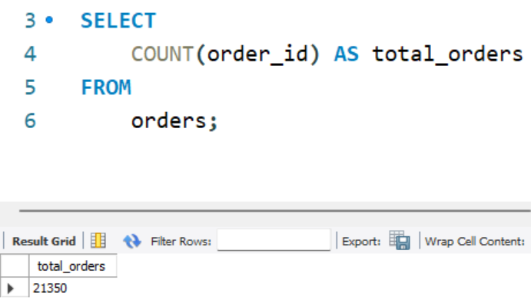



Question 1:
Retrieve the total number of orders placed.

Slide 4
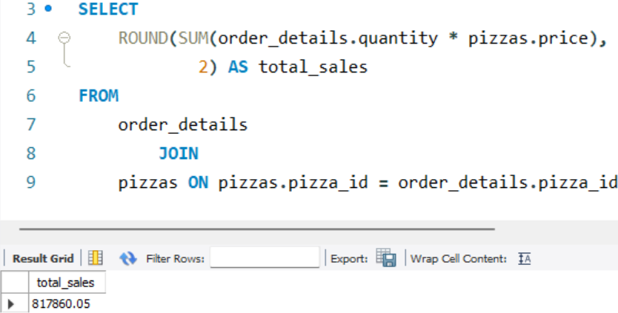



Question 2:
Calculate the total revenue generated from pizza sales.

Slide 5
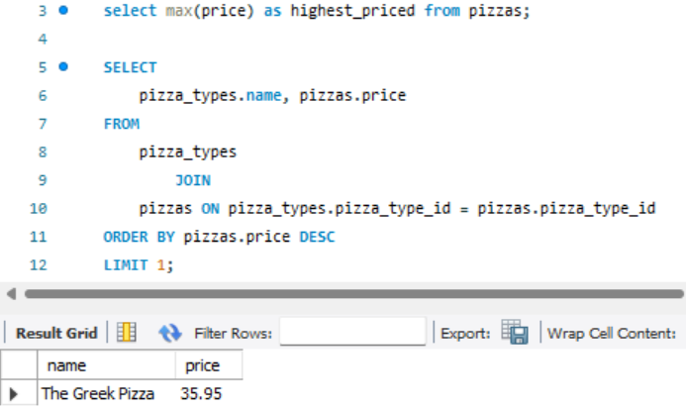

Question 3: Identify the highest-priced pizza.

Slide 6

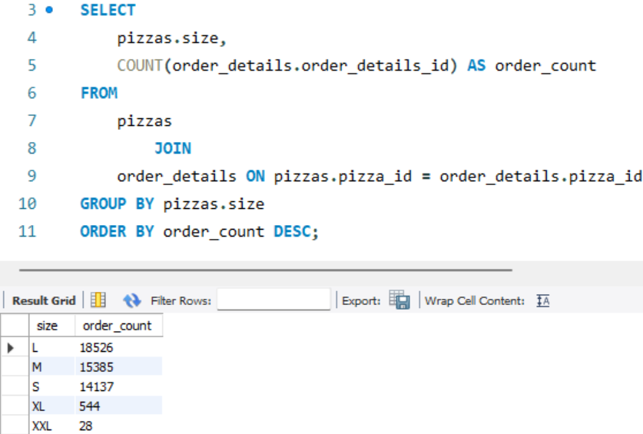

Question 4: Identify the most common pizza size ordered.

Slide 7

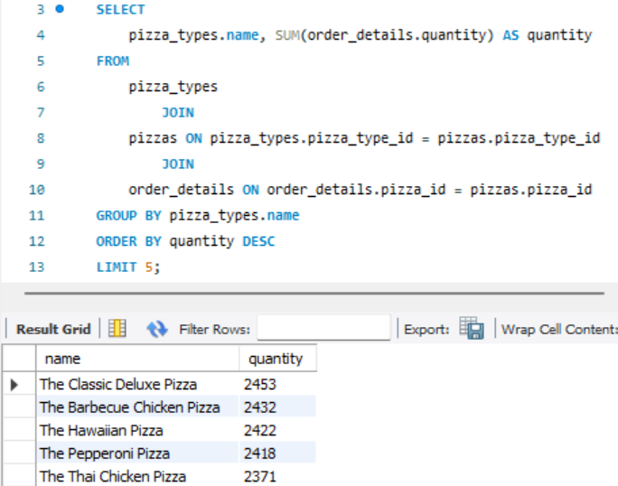

Question 5: List the top 5 most ordered pizza types along with
their quantities.

Slide 8

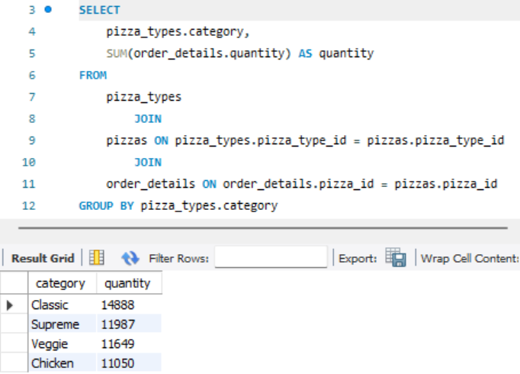
Question 6: Join the necessary tables to find the total quantity of each pizza category ordered.

Slide 9
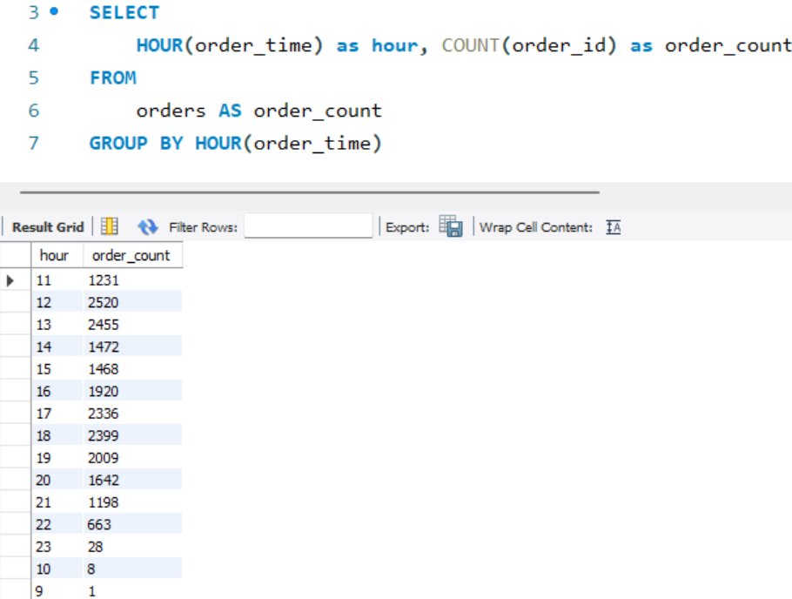

Question 7: Determine the distribution of orders by hour of the day.

Slide 10

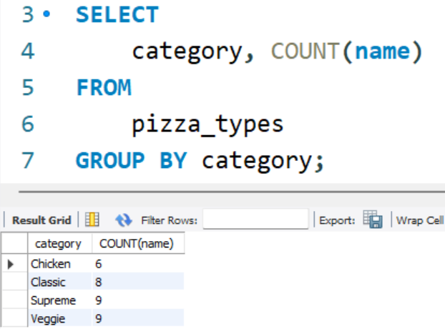
Question 8: Join relevant tables to find the category-wise distribution of pizzas.

Slide 11
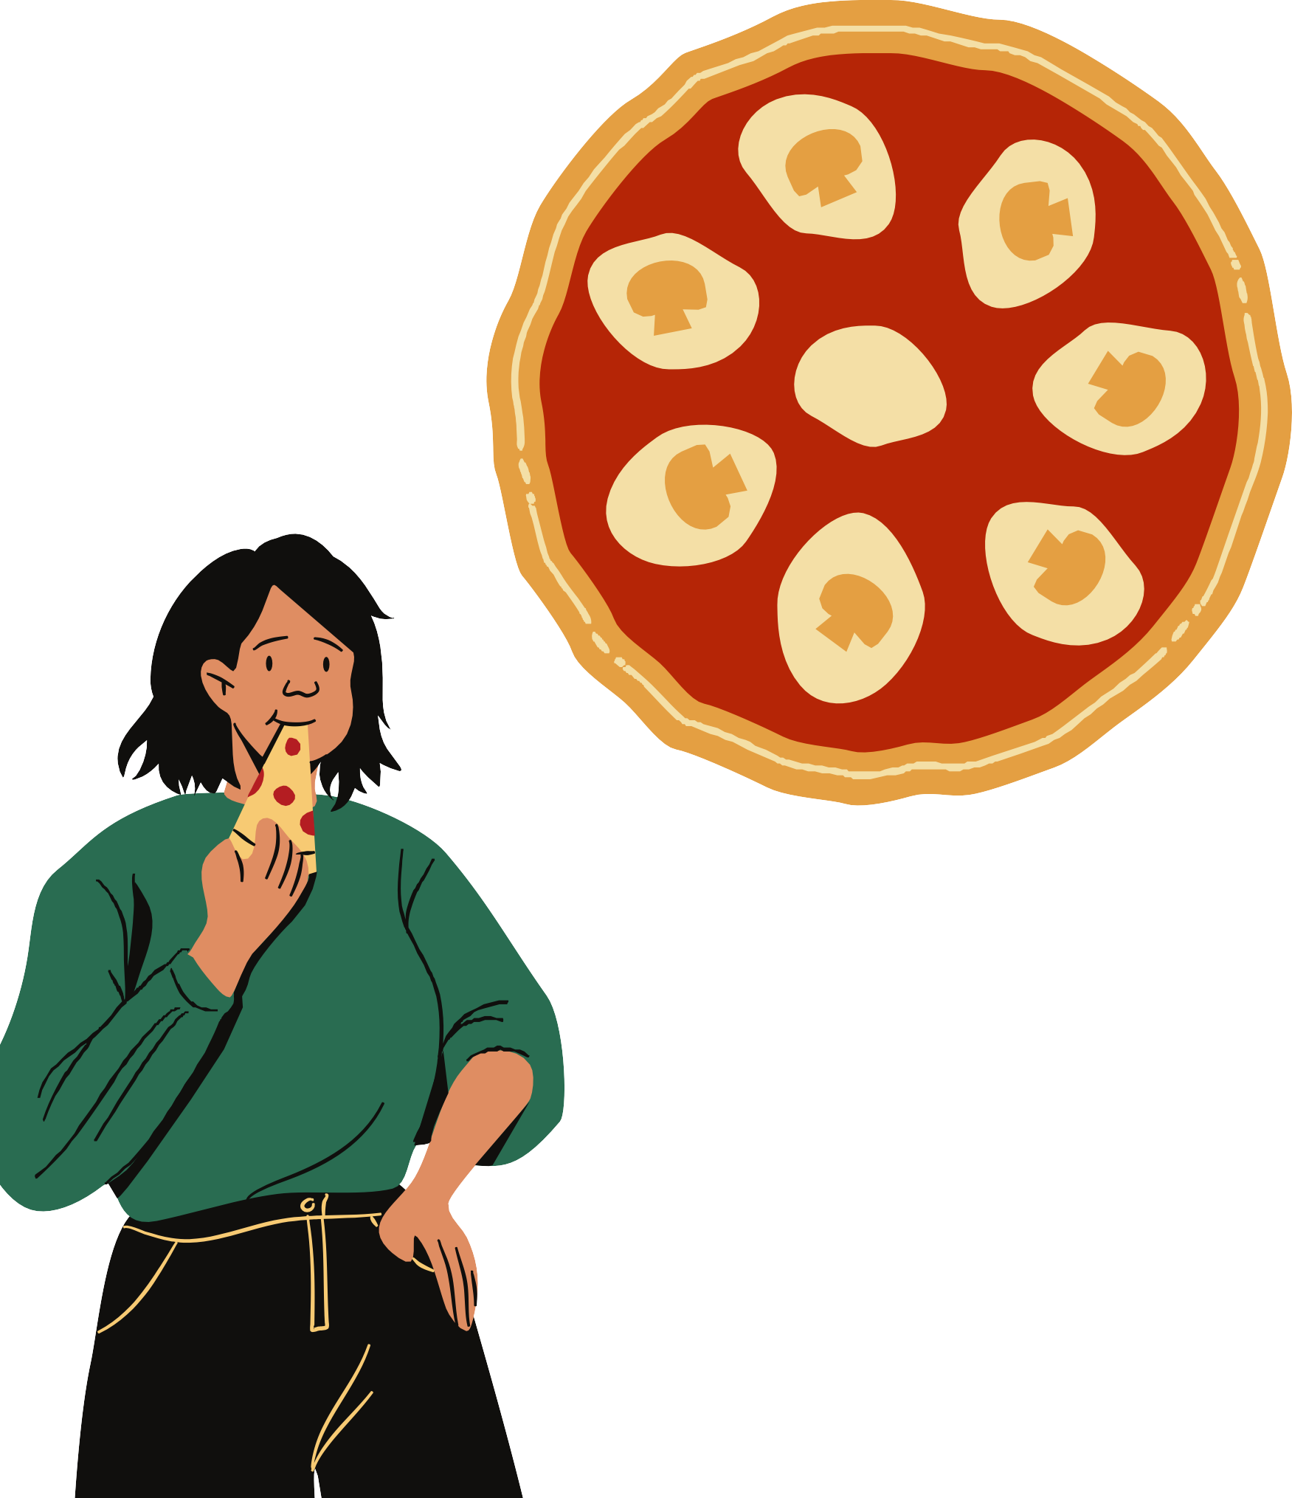
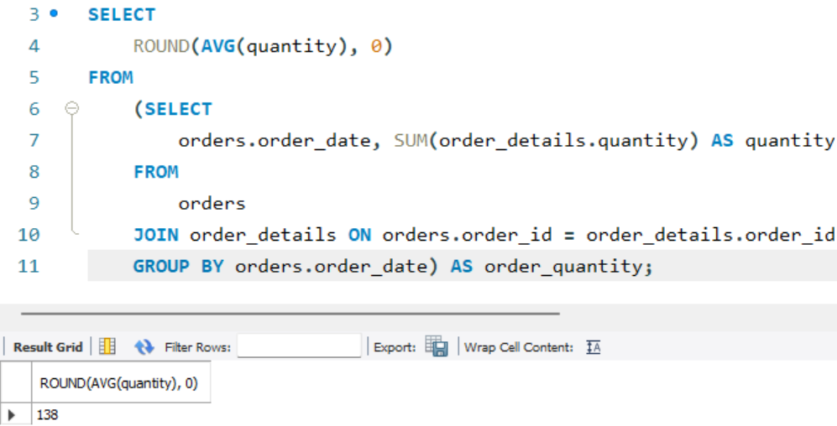




Question 9: Group the orders by date and calculate the average number of pizzas ordered per day.

Slide 12
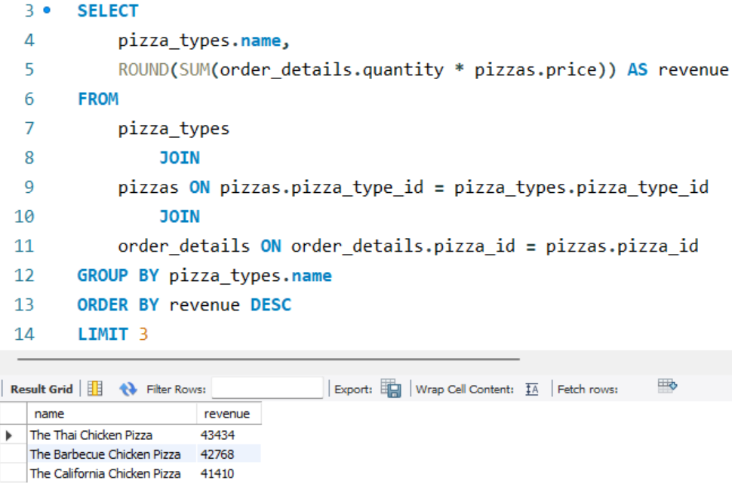


Question 10: Determine the top 3 most ordered pizza types
based on revenue.

Slide 13


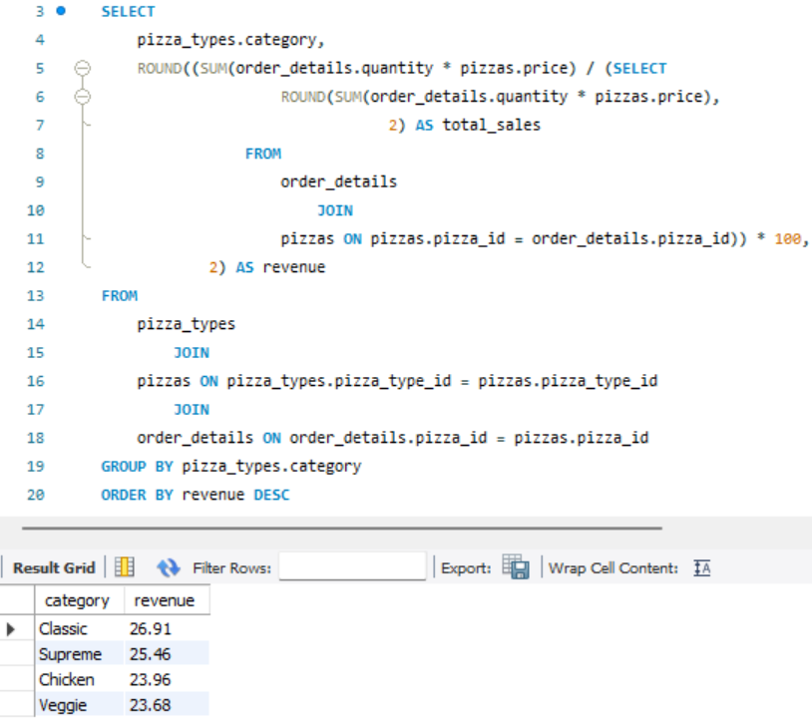
Question 11:
Calculate the percentage contribution of each pizza type to total revenue.

Slide 14





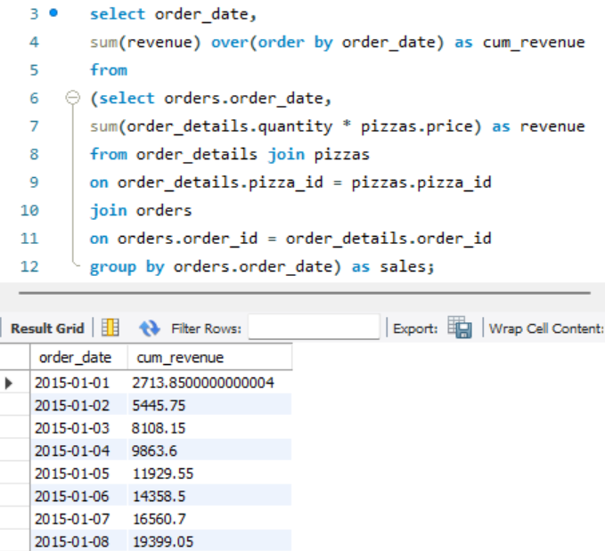
Question 12: Analyze the cumulative revenue generated over time.

Slide 15
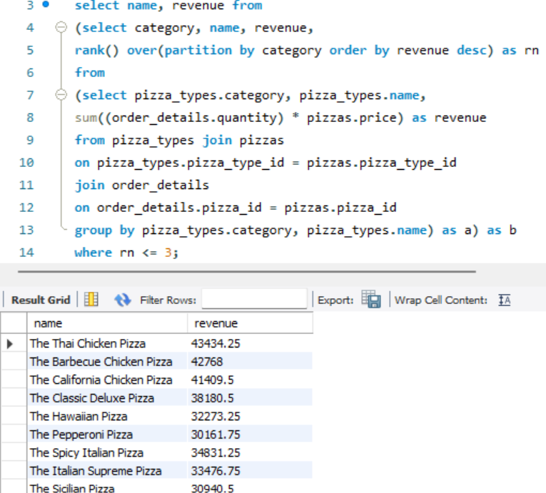
Question 13:
Determine the top 3 most ordered pizza types based on revenue for each pizza category.

Slide 16

Thank You
Savor the flavor of Data Analysis! 🍕📊

